Slide 1
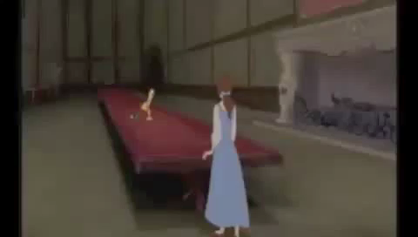
What type of story is this?
What are the characteristics of a fairy tale?
Notes:
Students agreed that it was a fairy tale. Then, I mentioned that a fairy tale is a category of literature. What do we call categories in literature?

Slide 2
Videos
http://www.youtube.com/watch?v=vDhUmn4IZ78
http://www.youtube.com/watch?v=3DwRqKoJaLg
Notes:
These are just videos on genres. My 7th graders watched them. My 9th graders didn’t need to.

Slide 3
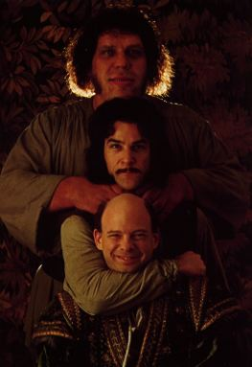
Background Information
The Princess Bride mimics a fairy tale by having with common archetypes (universal symbols)
“Inconceivable!”
Beginning/Ending
Characters
Royalty
Magic
Animals
Love
Conflict/Resolution
3s and 7s
A Hero
Notes:
Once upon a time…happily ever after
Good guy/bad guy
Princess/Prince Charming/Castle
Fairy Godmother/Witches
Animals help/talk
Love is in the air
3 little pigs, 3 godmothers in Sleeping Beauty, 7 dwarves. Numbers represent

Slide 4
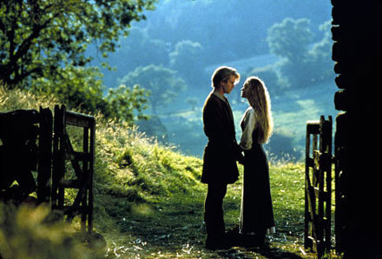
The Princess Bride: S. Morgenstern's Classic Tale of True Love and High Adventure (The 'Good Parts' Version) by William Goldman
“As you wish.”
Why would he pretend that it was written by someone else?
Original presentation downloaded from https://www.classjump.com/mrcollie/.../The%20Princess%20Bride.ppt. Modified for class use by Deb Salter.
Notes:
I noted that this was for authenticity. He wanted to make it feel like a classic fairy tale.

Slide 5
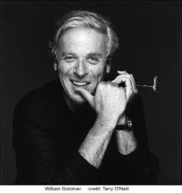
Author’s Biography
William Goldman
Born August 12, 1931, in Highland Park, IL
Novelist, playwright, and screenwriter.
Has won two Academy Awards: for writing Butch Cassidy and the Sundance Kid, and for adapting the screenplay of All the President's Men.
He has also written or consulted on The Stepford Wives, Misery, Chaplin, Good Will Hunting, and many other movies, as well as fiction, non-fiction, and children’s books.
Currently lives in New York City.
“This is my favorite book in all the world, though I have never read it.”

Slide 6
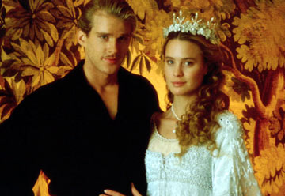
Background Information
The Princess Bride is considered to be a classic.
“A work of literature that is widely held to be one of the greatest creations within a given literary tradition.”
“This is true love - you think this happens every day?”

Slide 7
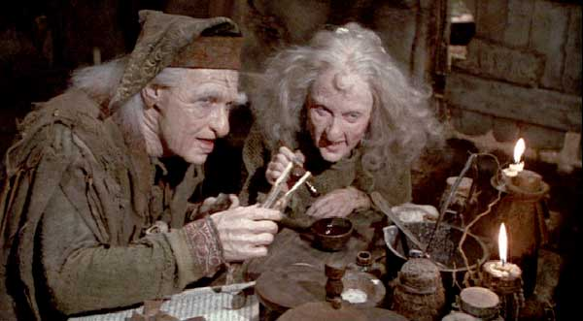
Background Information
The Princess Bride is a fantasy.
“A literary work that contains highly unrealistic elements and takes place in a non-existent and unreal world.”
“You rush a miracle man, you get rotten miracles.”
Notes:
I had them list examples of fantasy works.

Slide 8
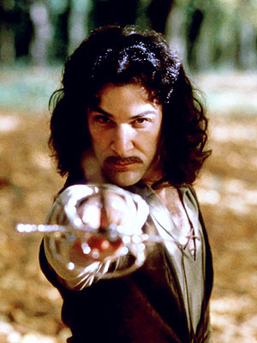
Literary Techniques
Preface: a statement made at the beginning of a literary work, often by way of introduction
Author Intrusion: narrative technique where the narrator interrupts the plot/story to share their opinion as to what is happening in the story
Satire: A work that uses humor, wit, and/or ridicule to point out the weaknesses in human nature and institutions and thereby provokes change
“Hello. My name is Inigo Montoya. You killed my father. Prepare to die!”

Slide 9
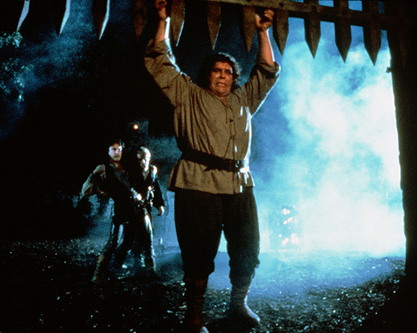
Narrative Structure
The Princess Bride is a frame narrative.
Story-telling structure wherein the main story contains one or more secondary stories. A character from the main story often becomes the narrator of the secondary story.
Main story (outer frame)
Examples of frame narratives:
Canterbury Tales
Arabian Nights
Secondary story/stories
(inner frame)
“Why won't my arms move?”
“You've been
mostly-dead
all day.”

